Slide 1

<Btech - CSE>
<1010103494>
< TrustShield AI: AI-Based Scam Detection Platform >
Project ID | CSE_M2_02
Enrollment No | 2301031800122
Name | Devanshi Barbhaya
Branch | Btech - CSE
Guide Name | Ms. Jenice Bhavsar

Slide 2
Index
Introduction
Background and Motivation
Relevance and Importance
Literature review
Objectives
Required Tools and Technology
Method/ Approach
Bibliography
10-09-2025
2

Slide 3
Introduction
Online scams are rising rapidly through WhatsApp, email, fake job offers, and fraudulent loan messages.
Students and elderly users are the most affected due to limited technical awareness.
Existing tools are single-purpose (only email filters OR only URL scanners) — no unified solution exists.
QR codes are an emerging scam vector ("quishing") — fake payment QR stickers, fraudulent parking/toll QR codes, WhatsApp-forwarded QR images — and almost no consumer tool checks these at all.
TrustShield AI proposes a single AI-powered platform with three input modes: paste suspicious text, paste a suspicious link, or upload a photo of a QR code — all checked for scam risk.

Slide 4
Background and Motivation
Digital fraud in India has grown sharply with UPI, online job portals, and instant-loan apps.
Common scam types: phishing links, fake job offers (asking for registration fees), fraudulent instant-loan apps, lottery/prize scams, and QR-code scams — fake UPI payment QR codes swapped at shops, malicious QR stickers on parking/toll machines, "scan to claim prize" QR codes in WhatsApp forwards.
Elderly and students are frequent victims due to trust in "official-looking" messages and QR codes, which most people assume are inherently safe simply because they look like a standard payment/scan code
Motivation: build an accessible, explainable, low-cost AI tool that acts as a "first line of defense" before a user clicks a link or shares personal information

Slide 5
Relevance and Importance
Who benefits: Students, elderly individuals, first-time internet/smartphone users, small business owners.
New insight contributed: A single explainable framework that unifies multi-class text scam classification, URL lexical + reputation-based risk scoring, and QR-code scam detection via image upload — three attack surfaces, one platform.
Why it matters: Reduces financial fraud losses, increases digital literacy, provides a free/low-cost alternative to enterprise-grade fraud tools.
Aligns with India's growing digital-payments and gig-economy ecosystem, where scam exposure is increasing

Slide 6
Literature Review
Phishing email detection has been studied using both machine learning and deep learning (CNN, LSTM, BERT) techniques (Sasirekha et al., 2023; Divakarla & Chandrasekaran, 2023).
Fake job posting detection has been explored using the EMSCAD dataset — Random Forest achieved up to 96.8% accuracy (IJRPR, 2024), while earlier LSTM-based approaches reached 89% accuracy (Vidros et al., 2017).
Malicious URL detection has been shown to work effectively using lightweight lexical features, without needing to crawl the destination site (Joshi et al., 2019).
QR-code phishing ("quishing") detection is an emerging research area — Trad & Chehab (2025) introduced the first framework to detect quishing by analyzing QR pixel-level structural patterns directly, without decoding the payload, achieving an AUC of 0.9106.
A 2026 systematic review confirmed quishing as a fast-growing, understudied threat that bypasses traditional email/URL filters entirely.
Research Gap: Each of these studies addresses only one scam channel in isolation — email, job postings, URLs, or QR codes. None combine text, link, and QR-based scam detection into a single accessible, explainable platform — this is the gap TrustShield AI aims to fill.

Slide 7
Objectives
To design a multi-class text classifier that detects phishing, fake job offers, and fraudulent loan scheme messages.
To build a URL risk scanner combining lexical analysis with real-time threat-database reputation checks.
To build a QR-code scam detection module that accepts an uploaded image, decodes the embedded QR payload, and routes it through the URL scanner — while also flagging structurally suspicious QR codes even before decoding.
To integrate all three modules (text, URL, QR/image) into a single, unified, easy-to-use platform.
To provide explainable output (reasons behind each verdict) rather than a simple binary label.
To deploy the system using a serverless, free-tier-compatible architecture for cost efficiency and scalability.

Slide 8
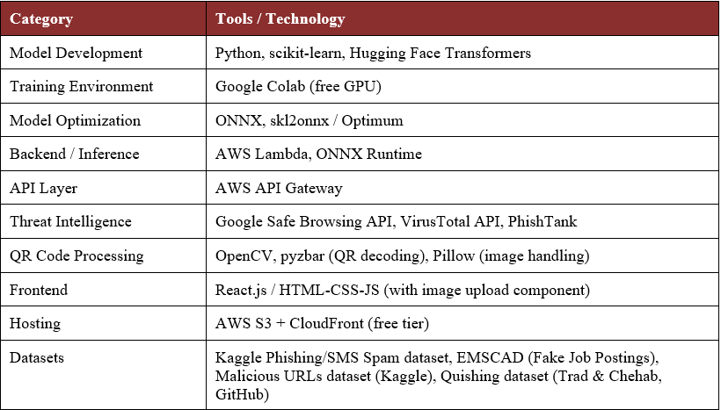
Required Tools and Technology
DEPARTMENT OF COMPUTER ENGINEERING
*Proprietary material of SILVER OAK UNIVERSITY

Slide 9
Method/ Approach
1. Text Scam Classifier
Preprocess pasted text (clean, tokenize) and extract TF-IDF + handcrafted features (urgency words, spelling errors, phone numbers)
Classify into: Legitimate / Phishing / Fake Job Offer / Loan Scam
Model trained in Colab, exported to ONNX for fast inference
2. URL Risk Scanner
Lexical analysis: URL length, IP-based links, hyphens, typosquatting distance from known brands
Reputation check via Google Safe Browsing, VirusTotal, and PhishTank APIs
Combines both into a single weighted risk score (0–100)
3. QR Code Scanner (Image Upload)
Structural check on QR pixel pattern flags suspicious codes before decoding
Decodes payload (URL / UPI ID / text) and routes it into Module 1 or 2 — reuses existing logic instead of duplicating it
Integration Layer
All three modules' results merged into one explainable verdict (risk level + plain-language reasoning)
Deployed serverless via AWS Lambda + API Gateway, kept within AWS free-tier limits

Slide 10
IEEE REFERENCES
1. T. Vidas, E. Owusu, S. Wang, C. Zeng, L. F. Cranor, and N. Christin, “QRishing: The susceptibility of smartphone users to QR code phishing attacks,” in Financial Cryptography and Data Security: FC 2013 Workshops, Okinawa, Japan, 2013, pp. 52–69, doi: 10.1007/978-3-642-41320-9_4.
2. R. Lakshmi S., S. G., and Durgaveni G., “SMS scam detection system using ML & NLP,” International Journal of Engineering Development and Research, vol. 14, no. 2, pp. 423–428, May 2026.
3. Y. Wang, H. Zhai, C. Wang, Q. Hao, N. A. Cohen, R. Foulger, J. A. Handler, and G. Wang, “Can you walk me through it? Explainable SMS-phishing detection using LLM-based agents,” in Proc. 21st USENIX Symposium on Usable Privacy and Security (SOUPS 2025), Seattle, WA, USA, 2025, pp. 37–56.
4. V. Sharma, S. Verma, A. Singh, and T. Gupta, “Detecting phishing in text messages,” International Journal of Modern Science and Research Technology, vol. 3, no. 3, pp. 335–340, Mar. 2025, doi: 10.5281/zenodo.15188546.
5. S. Vidros, C. Kolias, G. Kambourakis, and L. Akoglu, “Automatic detection of online recruitment frauds: Characteristics, methods, and a public dataset,” Future Internet, vol. 9, no. 1, p. 6, 2017, doi: 10.3390/fi9010006.

Slide 11
IEEE REFERENCES
6. D. Sahoo, C. Liu, and S. C. H. Hoi, “Malicious URL detection using machine learning: A survey,” arXiv preprint arXiv:1701.07179, 2017.
7. N. Reyes-Dorta, P. Caballero-Gil, and C. Rosa-Remedios, “Detection of malicious URLs using machine learning,” Wireless Networks, vol. 30, pp. 7543–7560, 2024, doi: 10.1007/s11276-024-03700-w.
8. A. Joshi, L. Lloyd, P. Westin, and S. Seethapathy, “Using lexical features for malicious URL detection—A machine learning approach,” arXiv preprint arXiv:1910.06277, 2019.
9. P. Sukarno and S. Ngah, “A heterogeneous dataset–driven ensemble learning framework for malicious URL detection,” International Journal of Advances in Data and Information Systems, vol. 7, no. 1, pp. 334–352, Apr. 2026, doi: 10.59395/ijadis.v7i1.1541.
10. F. Trad and A. Chehab, “Detecting quishing attacks with machine learning techniques through QR code analysis,” arXiv preprint arXiv:2505.03451, 2025.
DEPARTMENT OF COMPUTER ENGINEERING
*Proprietary material of SILVER OAK UNIVERSITY

